Slide 1
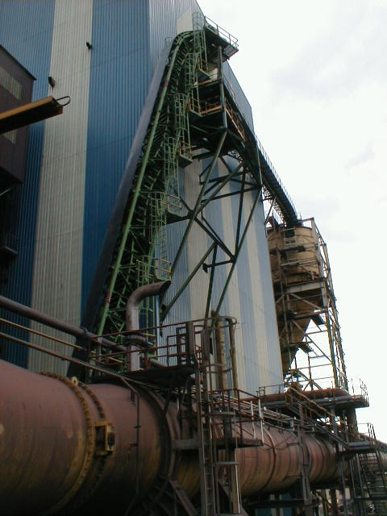
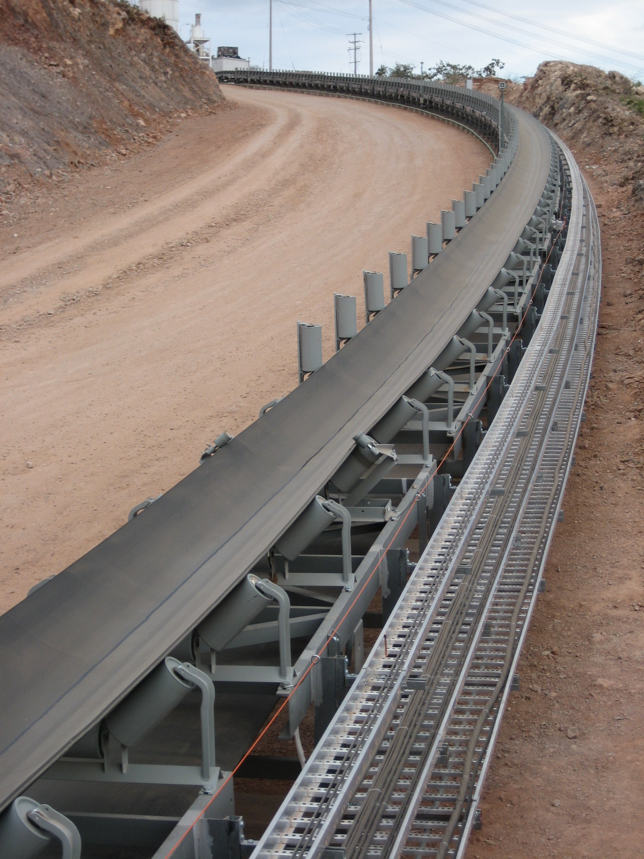
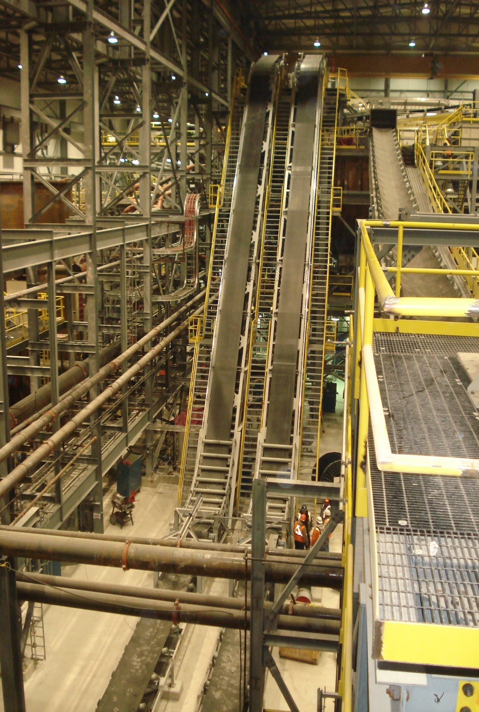
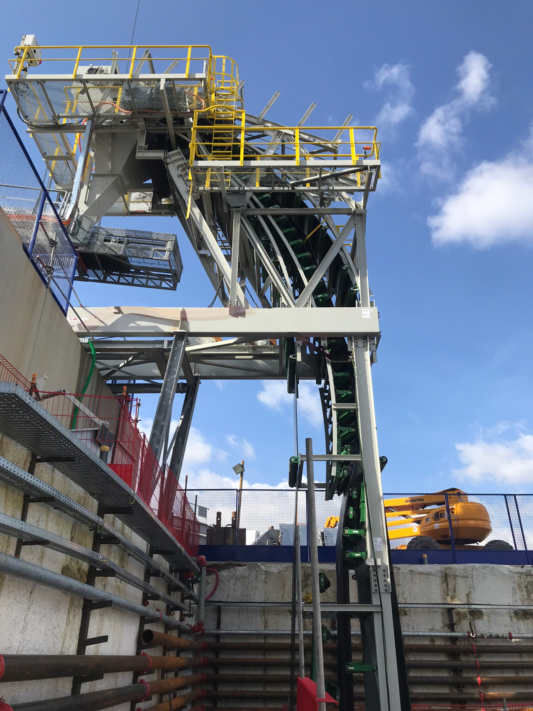
MATERIALS HANDLING &
ENGINEERING SPECIALISTS
A legacy of innovation.

Slide 2
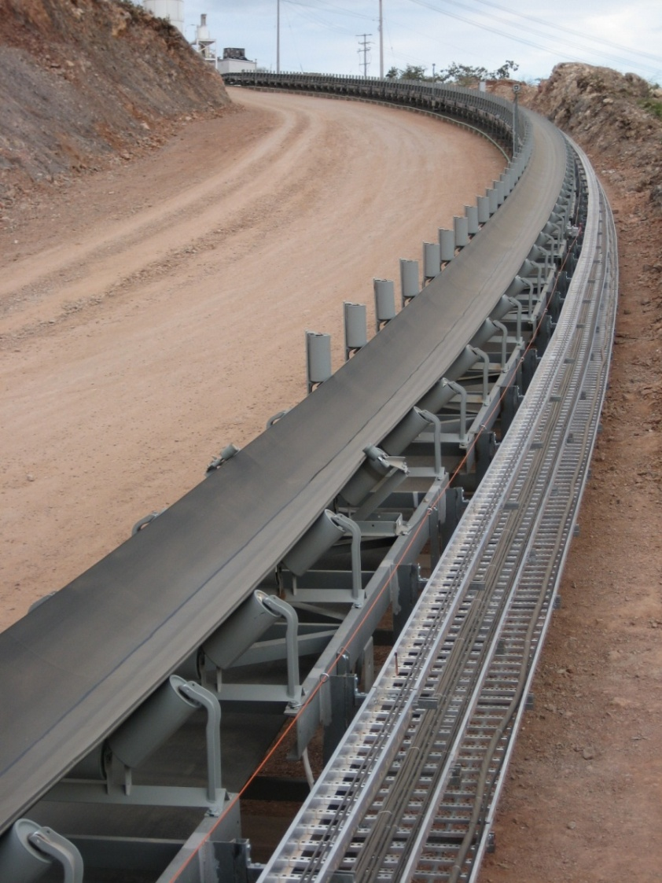
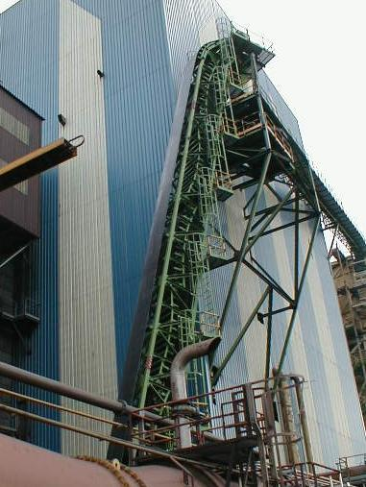
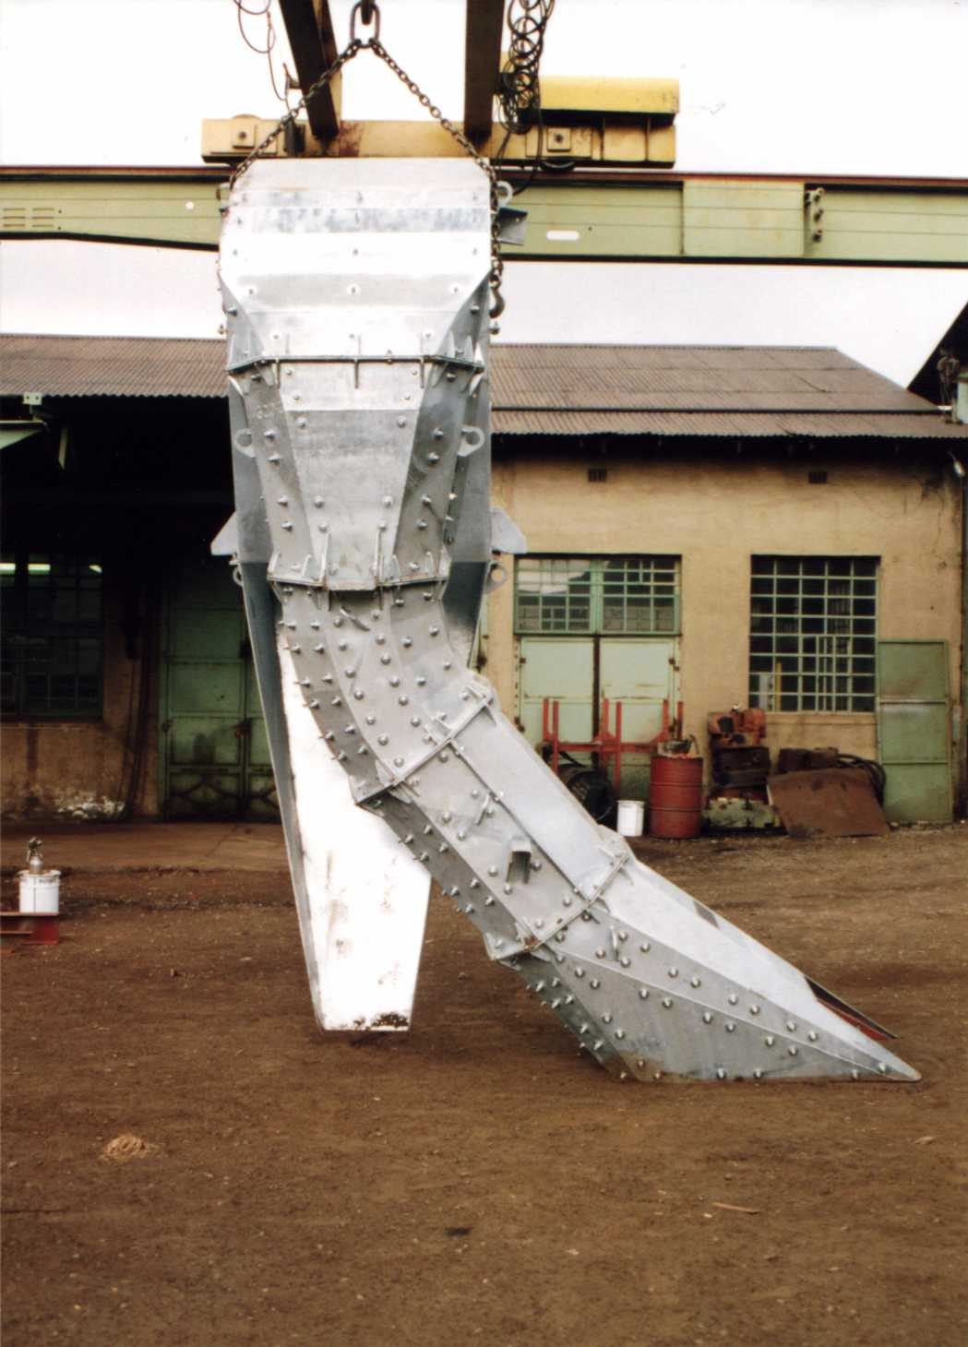
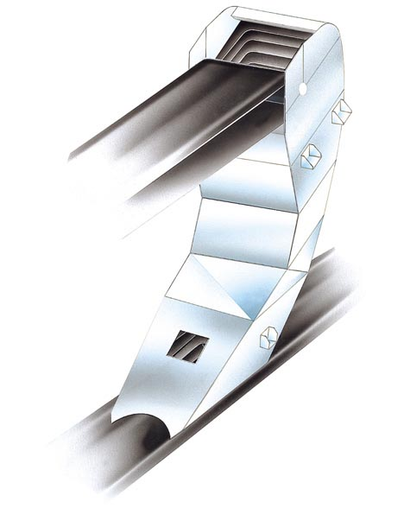
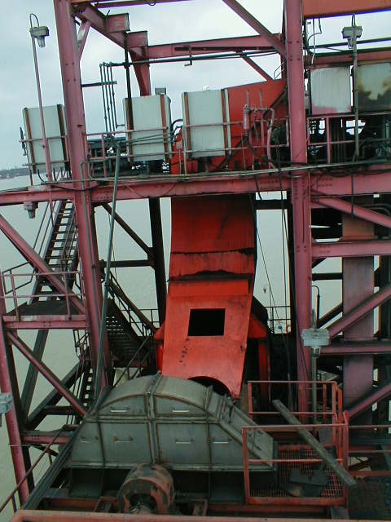
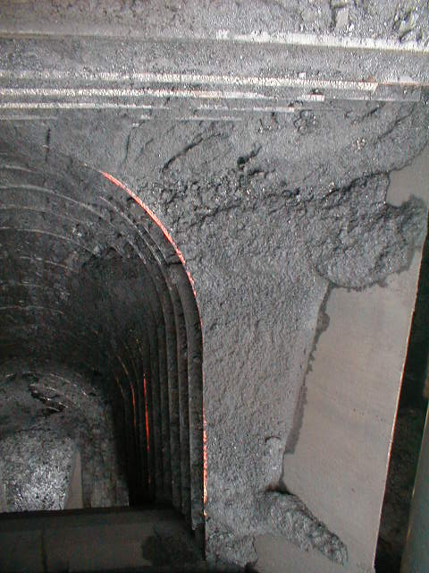
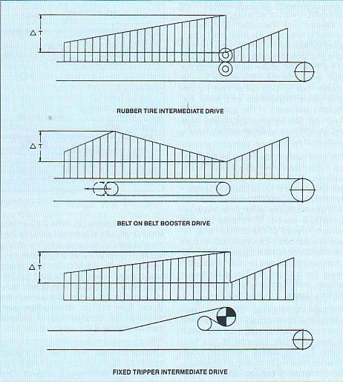
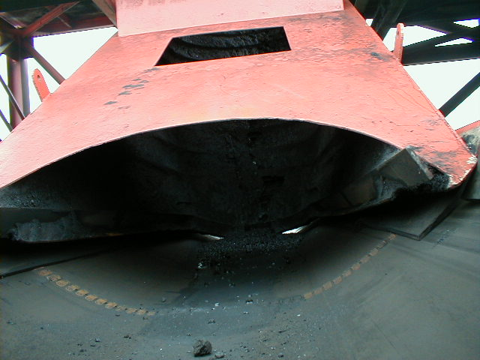
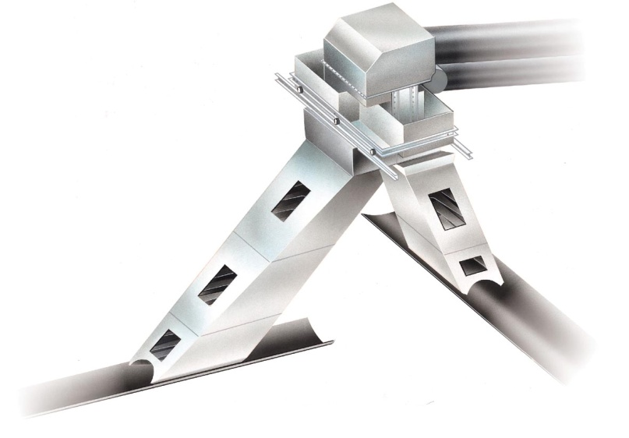
MATERIALS HANDLING AND
ENGINEERING SPECIALISTS
Long Overland, High Lift, and High Capacity Conveyors - including horizontally curving systems, TBM trailing conveyors
High Angle Conveyors – world’s foremost authority
High Tech Transfers – association with M&J/WEBA
Plant Conveyors
Heavy Belt Feeders
Booster Drives – able to convey great lengths with modest belt strength
WEBA Cascade
Transferring Coal at more than 9000 t/h

Slide 3
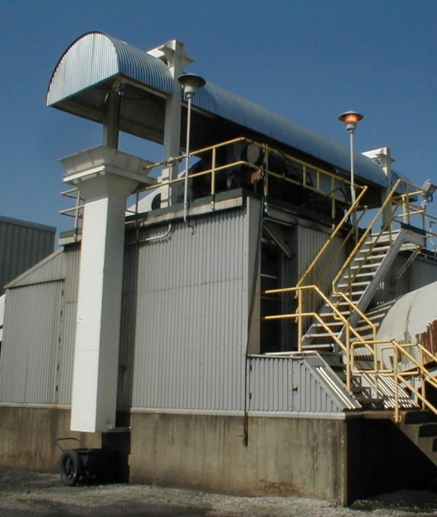
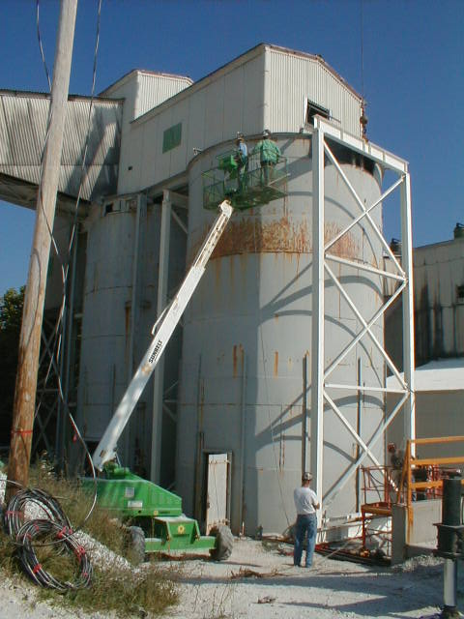
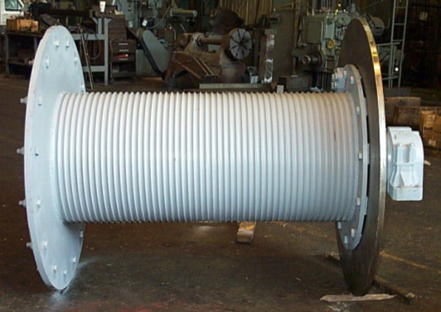
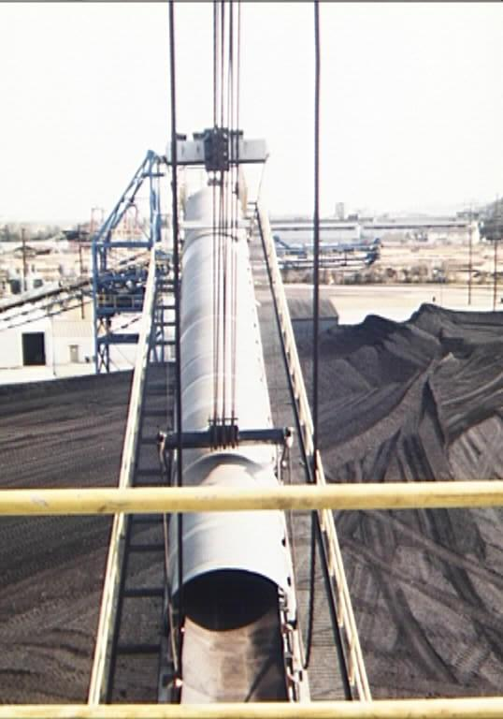
MECHANICAL AND
STRUCTURAL ENGINEERING
Rigging, reeving and hoisting
Engineering support of power plant maintenance contractors
Various miscellaneous plant projects

Slide 4
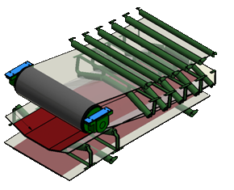
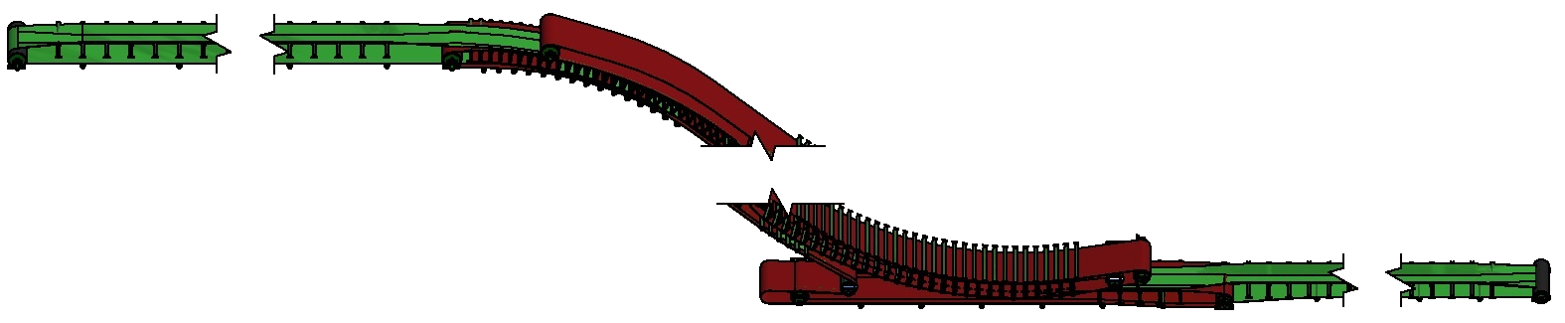
THE DSI ADDER SNAKE

Slide 5
DSI ExConTec
Complete Power/Tension Analysis Program
Real Time Analysis
Discretionary Factors

Slide 6
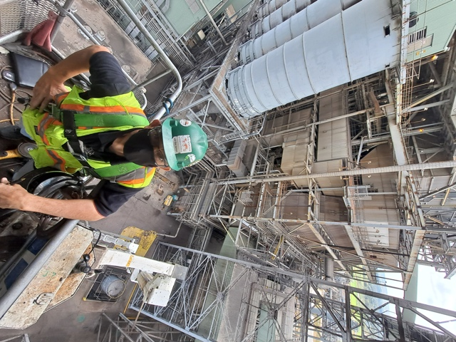
OUR RANGE
OF SERVICES
Technical and economic studies and evaluations
New Systems
Upgrade of existing systems
Plant modifications and field advisory assistance

Slide 7
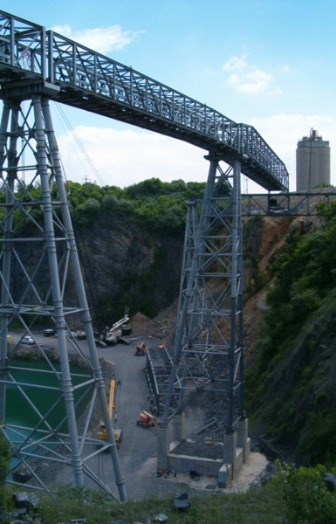
A MOST ADVANCED
OVERLAND CONVEYOR
Quarry to Cement Plants
Pennsylvania, USA
Notes:
The overland system that I’ll describe is designed and built by Continental Conveyor (Ontario) LTD of Napanee, Ontario, Canada. They chose Dos Santos International to do the complete analysis using our ExConTec proprietary software. For this and permission to share these advances, I wish to thanks the management of Continental Conveyor (Ontario) LTD

Slide 8
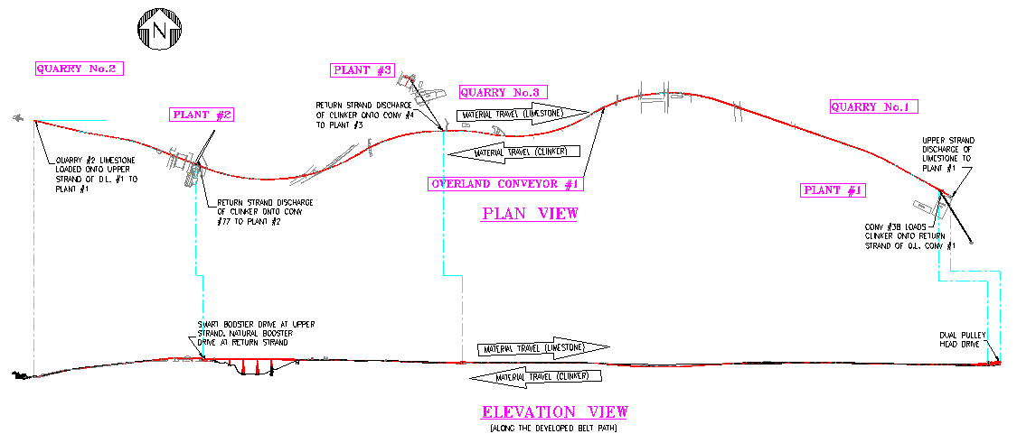
2.8 KILOMETER, TWO-WAY OVERLAND CONVEYOR
2.8 kilometer overland conveyor for an Eastern USA Cement Company
May be the world’s most advanced single flight conveyor system by virtue of the number of simultaneous advanced features, including:
Two way conveying, carrying crushed limestone, on the upper belt strand, and clinker on the return belt strand
Horizontally and vertically curving path featuring 9 horizontal curves, each with compound vertical curves
Belt turnovers, to utilize the thicker belt cover at the carrying side in either travel direction
Complete speed control with AC motors by variable frequency drives
Tripper type “Smart” booster (intermediate) drive at the upper belt strand
Tripper type “Natural” booster drive at the return strand
Multiple discharge points along the return strand
Notes:
2.8 km conveyor may be the world’s most advanced by virtue of the number of simultaneous advanced features
Bullets
Etc

Slide 9
2.8 KILOMETER, TWO-WAY OVERLAND CONVEYOR
DSI ExConTec Analysis quickly reveals the tension and power distribution due to various material flow conditions
Notes:
ExConTec analysis
Loading and unloading buttons
Independent at each strand
Reveals tension power take-up movement

Slide 10

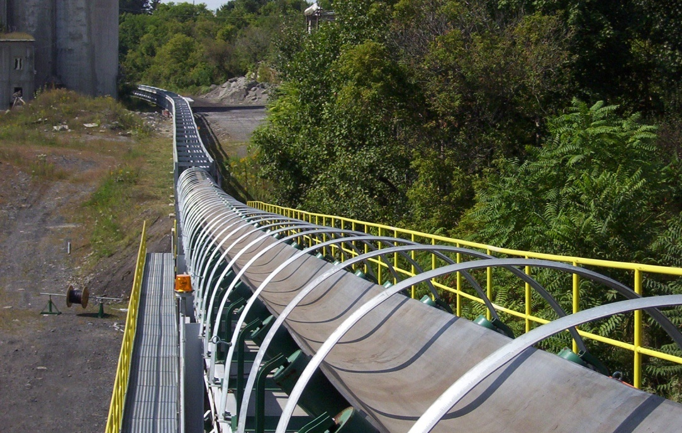
Notes:
Horizontal curve
Span over pit

Slide 11
DOWN HILL
CONVEYING
Gold Mine to Leaching Pads
Mezacala, Mexico
Notes:
The overland system that I’ll describe is designed and built by Continental Conveyor (Ontario) LTD of Napanee, Ontario, Canada. They chose Dos Santos International to do the complete analysis using our ExConTec proprietary software. For this and permission to share these advances, I wish to thanks the management of Continental Conveyor (Ontario) LTD

Slide 12
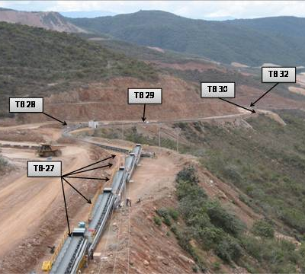
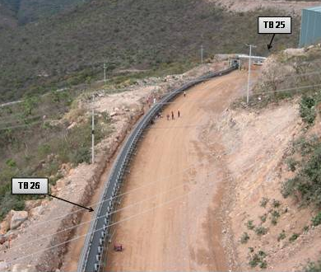
DSI OVERLAND CONVEYOR SYSTEM

Slide 13
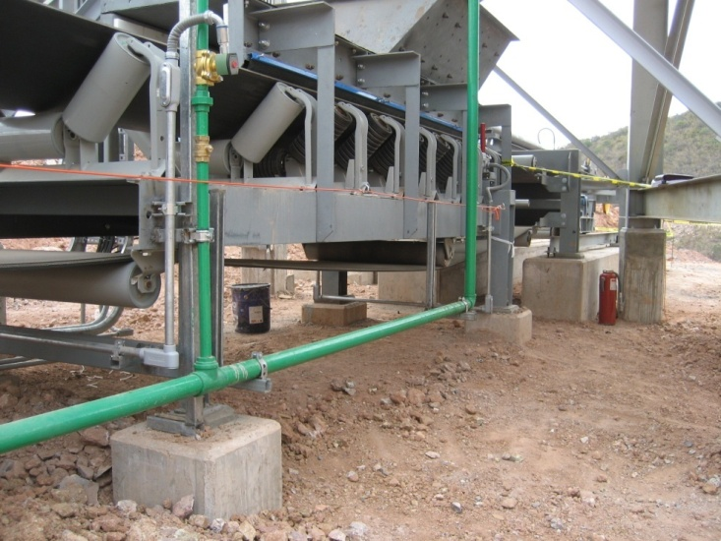
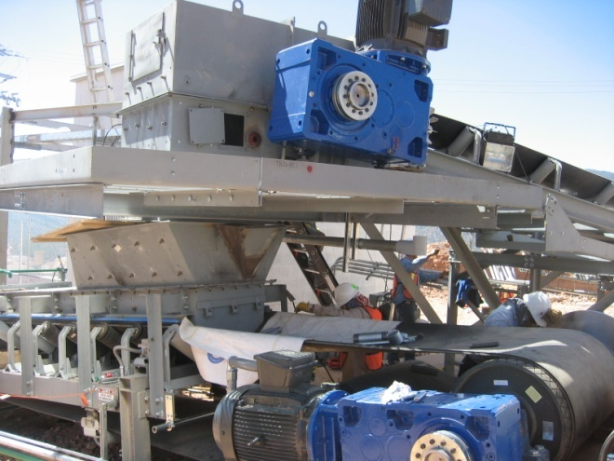
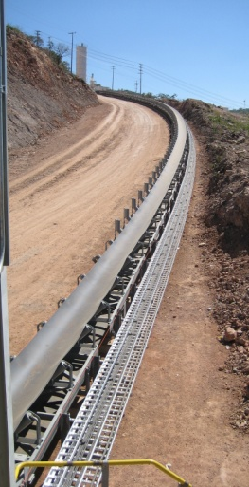
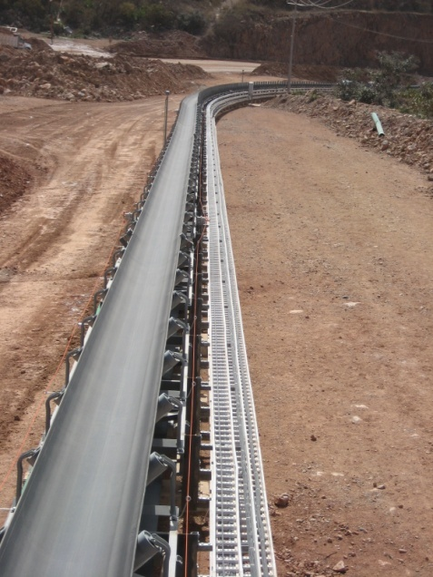
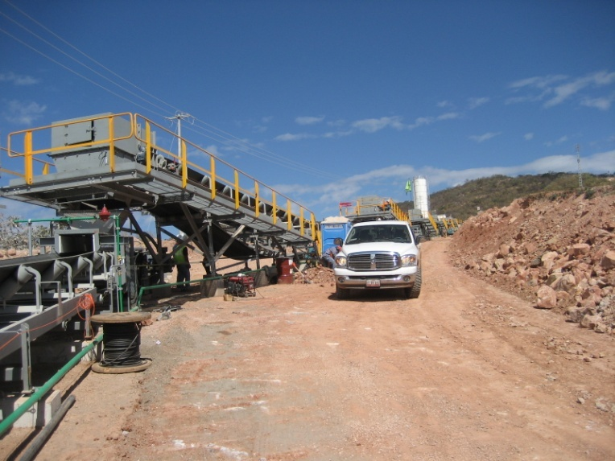
TB27 TAIL DRIVE, LOADING
TB26 HEAD DRIVE, DISCHARGE
TB26 TAIL LOADING
TB28 TAIL DRIVE,
TAKE-UP, LOADING
TB27 HEAD DISCHARGE

Slide 14
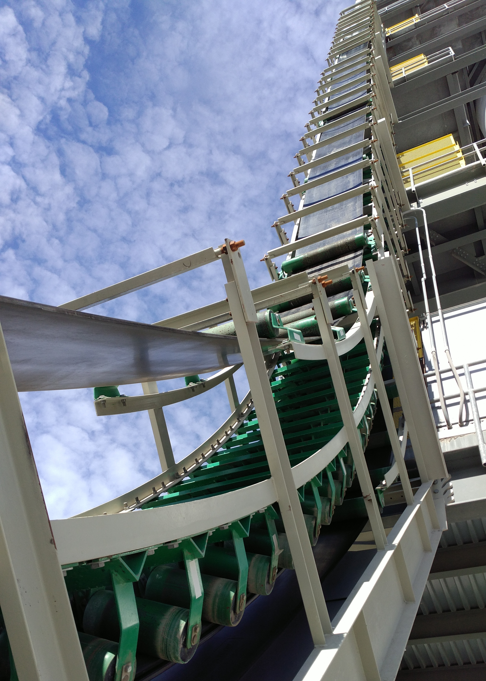
SANDWICH BELT HIGH ANGLE CONVEYORS
History
The Technology
Installations

Slide 15
PRODUCT OF EVOLUTION
FROM RESEARCH TO REALITY

Slide 16
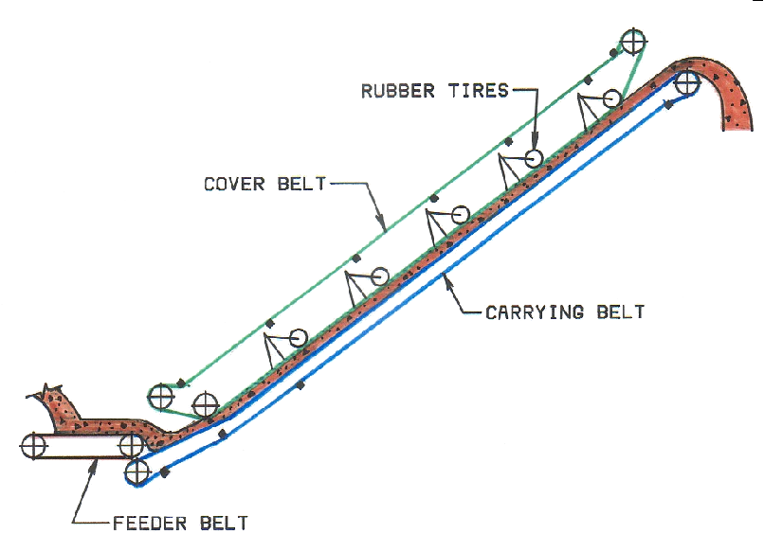
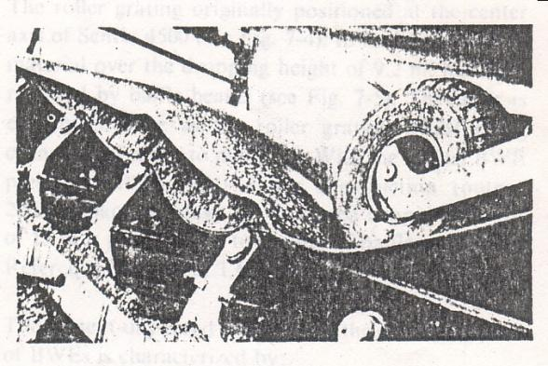
COVER BELTS OF THE 1950s
RUBBER TYRES PRESS COVER BELT ONTO MATERIAL

Slide 17
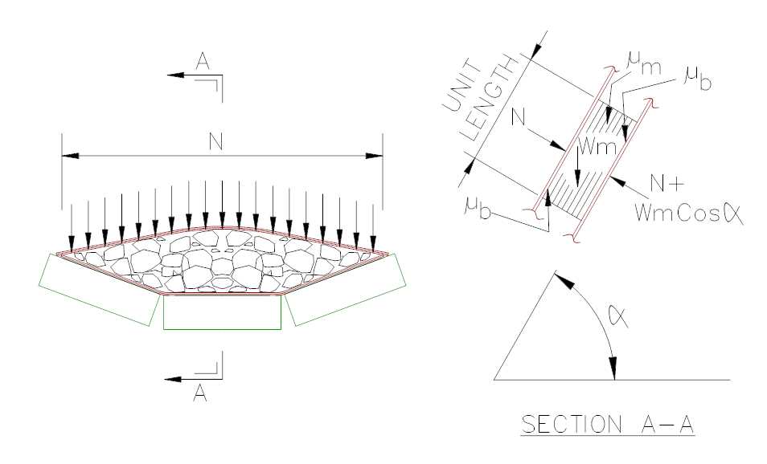
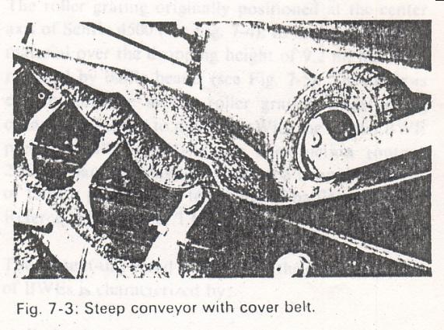
COVER BELTS OF THE 1950s
SANDWICH BELT MODEL #1
α = Conveying Angle
μ_{m} = Coefficient of friction for bulk material on bulk material
μ_{b} = Coefficient of friction for bulk material on belt
N = Normal lineal hugging load exerted by the top belt
Wm = Lineal weight of bulk material

Slide 18
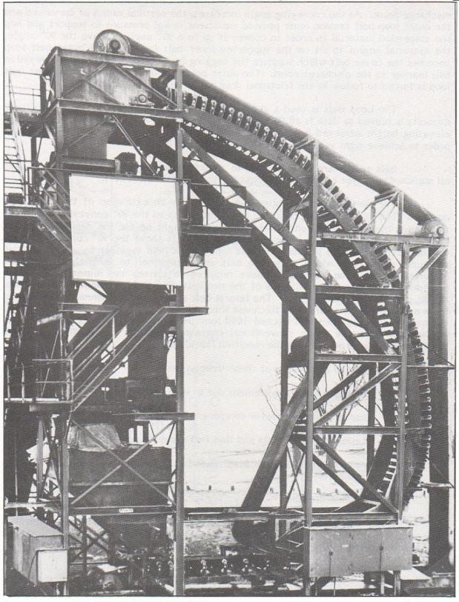
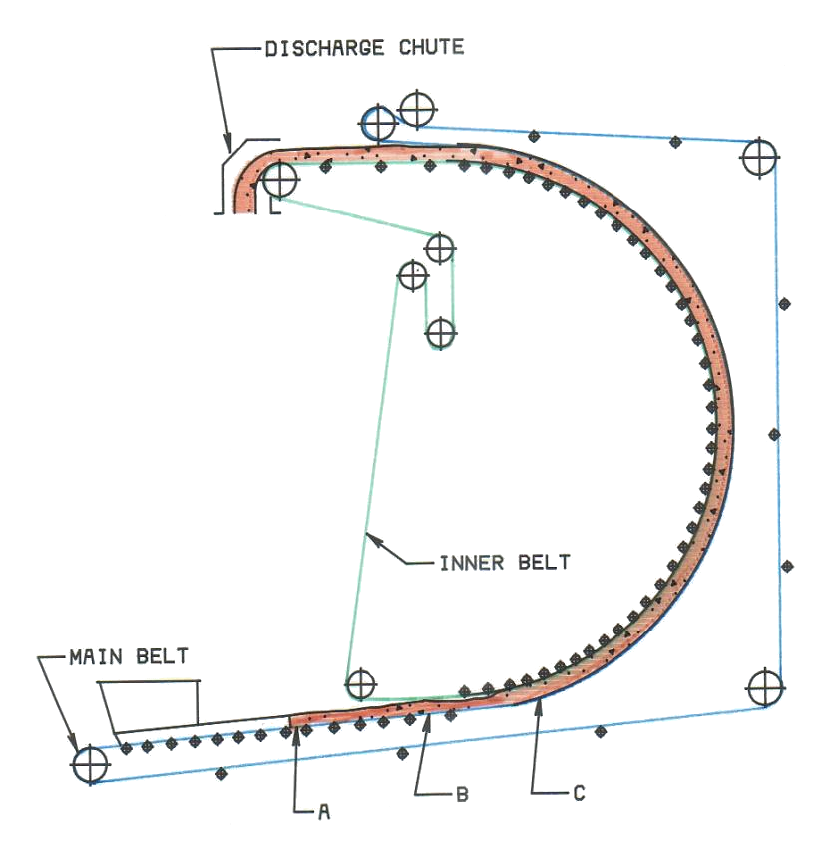
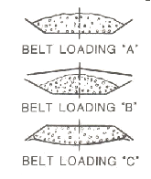
LOOP BELTS OF THE 1970s
First use of radial pressure due to tension

Slide 19
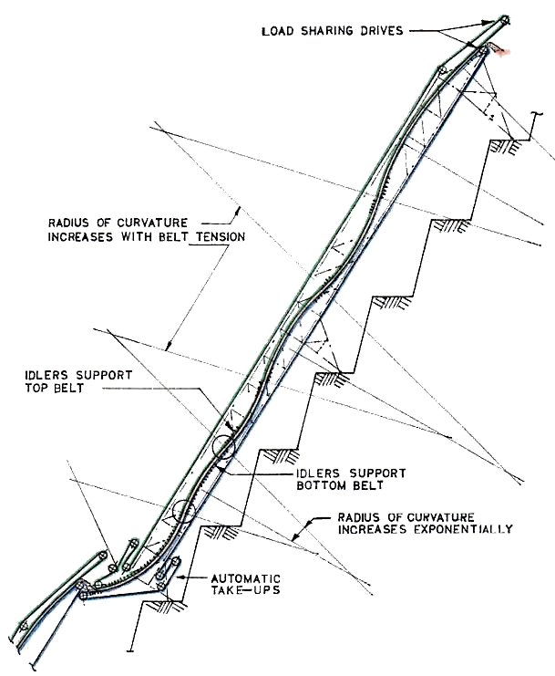
DOS SANTOS
SANDWICH
BELTS OF THE
1980s
THE PROPHECY
A Sandwich Belt High Angle Conveyor, rationalized in the Conventional Conveyor Technology, will have the operating characteristics of a conventional conveyor:
High reliability and availability
Low operating and maintenance

Slide 20
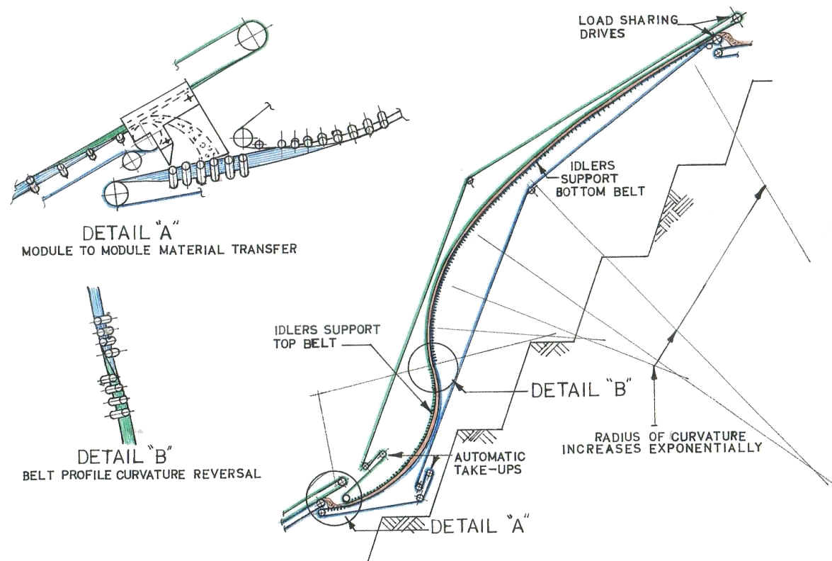
S-SHAPE SANDWICH CONVEYOR
SCHEMATIC

Slide 21
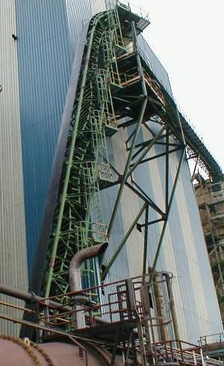
SNAKE SANDWICH CONVEYOR
SCHEMATIC
First disclosure of Snake Sandwich High Angle Conveyor

Slide 22
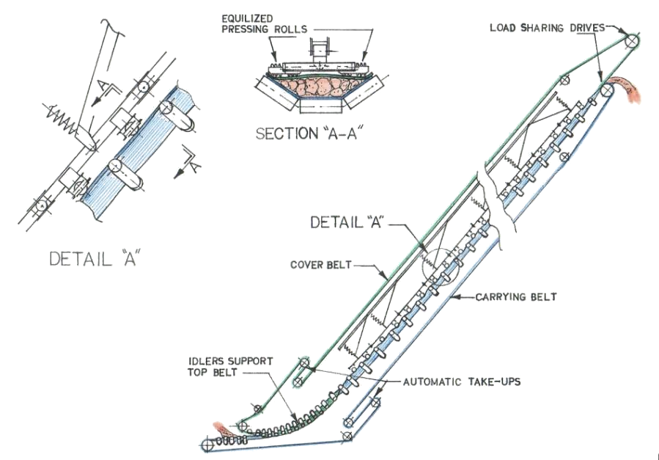
MECHANICALLY PRESSED SANDWICH CONVEYOR
First disclosure of Mechanically Pressed Sandwich High Angle Conveyor

Slide 23
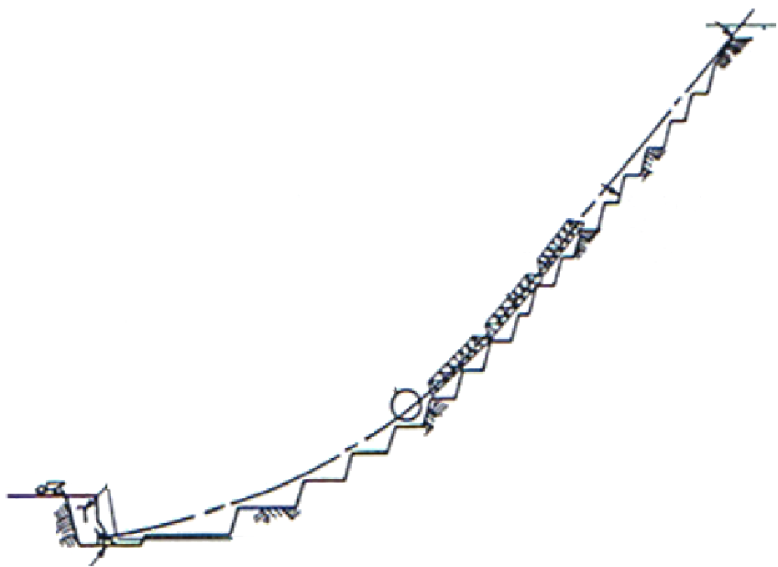
MECHANICALLY PRESSED SANDWICH CONVEYOR
STEEL CORD BELT SOLUTION

Slide 24
CONTINUITY OF HUGGING PRINCIPLE
CONTINUOUS & UNIFORM
Material Hugging Pressure must be continuous and uniform. It must hug all of the material always, without lapse even at the smallest scale.
RADIAL PRESSURE
Radial pressure due to belt tension is the ideal and natural way to apply hugging pressure.
PRESSURE THROUGH PRESSING ROLLS
Applied pressure through pressing rolls must continuously distribute the pressing load by close spacing and full equalization. Such is the DSI GPS.

Slide 25
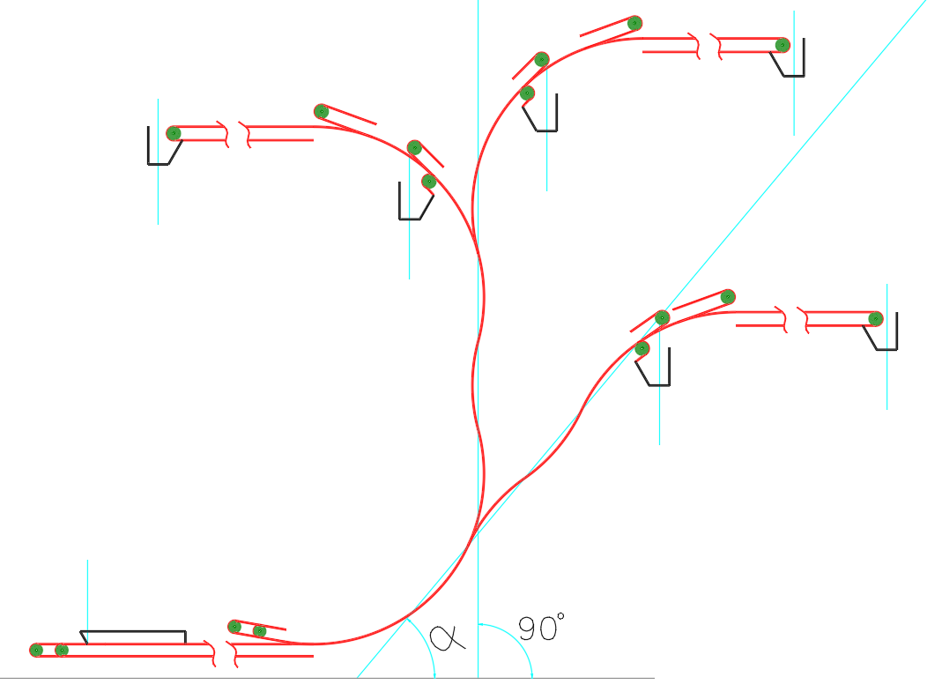
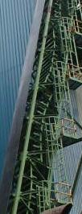
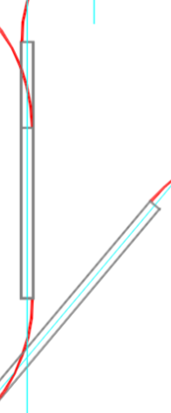
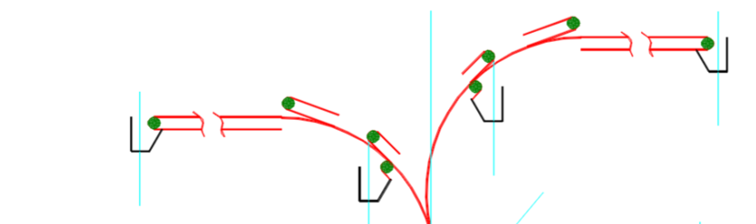
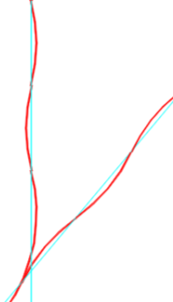
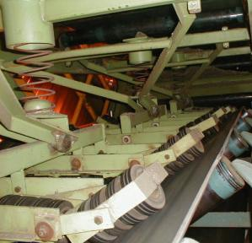
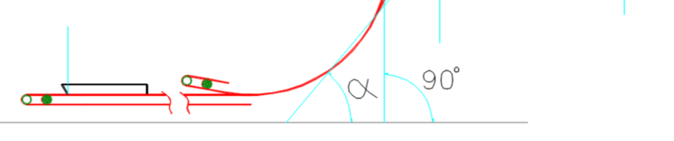



BASIC PROFILES
EXTENDED PROFILES
SNAKE
GPS

Slide 26

DSI SANDWICH HIGH ANGLE CONVEYOR
7
8
6
5
Sample Profile
and Details
4
1
3
2

Slide 27


7
8
6
5
4
1
3
2
1. Loading onto bottom belt between skirts

Slide 28

7
8
6
5
4
1
3
2
2. Top belt joins bottom belt to sandwich material

Slide 29

7
8
6
5
4
1
3
2
3. Curve 1, bottom belt hugs material against top belt

Slide 30

7
8
6
5
4
1
3
2
4. Inflection 1 between curves 1 and 2

Slide 31

7
8
6
5
4
1
3
2
5. Inflection 2 between curves 2 and 3

Slide 32

7
8
6
5
4
1
3
2
6. Inflection 3 between curves 3 and 4

Slide 33

7
8
8
5
4
1
3
2
7. Top belt departs from curve 4 to its head/drive pulley

Slide 34

7
8
8
5
4
1
3
2
8. Material discharge at head pulley

Slide 35
SANDWICH BELT HIGH ANGLE CONVEYORS
Important Features:
General: DSI Sandwich Belt High Angle Conveyors use all conventional conveyor equipment including smooth surfaced rubber belts that can be continuously scraped clean. They feature the operating characteristics of conventional conveyors; high reliability, low O&M costs
Capacity: Unlimited, with wide belts at typical belt speeds rates can exceed 10000 t/h
Material Size: Large belts can handle large lumps, 300mm +
Belt Speed: Recommended belt speeds are same as conventional conveyors and may exceed 5m/s in some industries
Belt Width: Unlimited, belt width is available to 3000mm wide and beyond

Slide 36

AT MINES
AND QUARRIES
(IN-PIT CRUSHING
AND CONVEYING)
Most common concern
Large belt, large lumps
Select applications

Slide 37
THE MOST COMMON CONCERN
Are Sandwich High Angle Conveyors suitable for in-pit mining applications?
Can they handle very high conveying rates?
Are they suitable for continuous operation 24/7?
Can they handle large, heavy, primary crushed ore and waste rock?

Slide 38

LARGE BELTS CAN HANDLE LARGE LUMPS
SMALL BELTS HANDLE SMALL LUMPS

Slide 39

DSI SANDWICH BELT
HIGH ANGLE CONVEYOR
vs
MEGA-PIPE

Slide 40

SELECT APPLICATIONS
AT MINES AND FACILITIES

Slide 41









DSI Snake #1 Sandwich Conveyor
for
Victor Diamond Mine Project
Material - Kimberlite
- Density - 1.6 t/cu-m (100 PCF)
- Size - 28 mm (1.1”) minus
Conveying Rate - 381 t/h (420 STPH)
Conveying Angle - 49.5 degrees
Belt Width - 1067 mm (42”)
Belt Speed - 2 m/s (394 FPM)
Lift - 18,508 mm (60.7’)
Length - 67,581 mm (221.7’)
Snake Drives
- Top Belt - 29.83 kW (40 HP)
- Bottom Belt - 29.83 kW (40 HP)
DSI Snake #2 Sandwich Conveyor
for
Victor Diamond Mine Project
Material - Kimberlite
- Density - 1.6 t/cu-m (100 PCF)
- Size - 6 mm (1/4”) minus
Conveying Rate - 185 t/h (204 STPH)
Conveying Angle - 49.5 degrees
Belt Width - 1067 mm (42”)
Belt Speed - 1.0 m/s (197 FPM)
Lift - 18,508 mm (60.7’)
Length - 65,981 mm (216.5’)
Snake Drives
- Top Belt - 18.65 kW (25 HP)
- Bottom Belt - 18.65 kW (25 HP)
DSI Snake #2 Sandwich Conveyor
for
Continental CN at Snap Lake Diamond Mine
(Initial / Future)
Material - Kimberlite
- Density - 1.6 t/cu-m (100 PCF)
- Size - 50 mm (2”) minus
Conveying Rate - 250/500 t/h (276/552 STPH)
Conveying Angle - 49.5 degrees
Belt Width - 914 mm (36”)
Belt Speed - 1.5/2.2 m/s (295/433 FPM)
Lift - 18,310 mm (60.1’)
Length - 70,562 mm (231.5’)
Snake Drives
- Top Belt - 22.4/44.8 kW (30/60 HP)
- Bottom Belt - 22.4/44.8 kW (30/60 HP)
DSI Snake #1 Sandwich Conveyor
for
Continental CN at Snap Lake Diamond Mine
(Initial / Future)
Material - Kimberlite
- Density - 1.6 t/cu-m (100 PCF)
- Size - 32 mm (1.3”) minus
Conveying Rate - 275/550 t/h (303/606 STPH)
Conveying Angle - 49.5 degrees
Belt Width - 914 mm (36”)
Belt Speed - 1.5/2.2 m/s (295/433 FPM)
Lift - 18,310 mm (60.1’)
Length - 39,015 mm (128’)
Snake Drives
- Top Belt - 22.4/44.8 kW (30/60 HP)
- Bottom Belt - 22.4/44.8 kW (30/60 HP)
Downhill Sandwich Conveyor
from
Phosphate Mine, Venezuela
Material - Phosphate Rock
- Density - 1.60 t/cu-m (100 PCF)
- Size - 6.3 mm (1/4”) minus
Conveying Rate - 668 t/h (736 STPH)
Conveying Angle - 35.5 degrees
Belt Width - 914 mm (36”)
Belt Speed - 2.29 m/s (450 FPM)
Elevation Drop - 34,000 mm (111.5’)
Length - 113,000 mm (371’)
Drive
- Bottom Belt - 93.2 kW (125 HP)
DSI Snake Sandwich Conveyor
for
Empire Iron Ore Mining Partnership
Material - Iron Ore
- Density - 2.4 t/cu-m (150 PCF)
- Size - 2 mm (.08”) minus
Conveying Rate - 793 t/h (780 LTPH)
Conveying Angle - 65 degrees
Belt Width - 1067 mm (42”)
Belt Speed - 2.29 m/s (450 FPM)
Lift - 11,522 mm (37.8’)
Length - 21,489 mm (70.5’)
Snake Drives
- Top Belt - 29.8 kW (40 HP)
- Bottom Belt - 37.3 kW (50 HP)
Sandwich Conveyor
for
Gold Mine, Western USA
Material - Gold Ore
- Density - 1.6 t/cu-m (100 PCF)
- Size - 250 mm (10”) minus
Conveying Rate - 689 t/h (760 STPH)
Conveying Angle - 50 degrees
Belt Width - 1219 mm (48”)
Belt Speed - 1.65 m/s (325 FPM)
Lift - 28,900 mm (95’)
Length - 58,400 mm (191.5’)
Drives
- Top Belt - 37.3 kW (50 HP)
- Bottom Belt - 56 kW (75 HP)
Sandwich Conveyor
for
Coal Prep Plant, Eastern USA
Material - Refuse
- Density - 1.28 t/cu-m (80 PCF)
- Size - 135 mm (5.3”) minus
Conveying Rate - 454 t/h (500 STPH)
Conveying Angle - To 41 degrees
Belt Width - 914 mm (36”)
Belt Speed - 2.34 m/s (460 FPM)
Lift - 174,800 mm (574’)
Length - 454,200 mm (1490’)
Drives
- Top Belt - 186.5 kW (250 HP)
- Bottom Belt - 186.5 kW (250 HP)
DS 012
Sandwich Conveyor
for
Copper Mine, Eastern Europe
Material - Copper Ore
- Density - 2.08 t/cu-m (130 PCF)
- Size - To 250 mm (10”) minus
Conveying Rate - 4000 t/h (4409 STPH)
Conveying Angle - 35.5 degrees
Belt Width - 2000 mm (78.7”)
Belt Speed - 2.85 m/s (561 FPM)
Lift - 93,500 mm (307’)
Drives
- Top Belt - 450 kW (600 HP)
- Bottom Belt - 2x450=900 kW (1200 HP)
DSI Snake #3 Sandwich Conveyor
for
Victor Diamond Mine Project
Material - Kimberlite
- Density - 1.6 t/cu-m (100 PCF)
- Size - 28 mm (1.1”) minus
Conveying Rate - 422 t/h (465 STPH)
Conveying Angle - 60 degrees
Belt Width - 1067 mm (42”)
Belt Speed - 2 m/s (394 FPM)
Lift - 11,886 mm (39.0’)
Length - 33,282 mm (109.2’)
Snake Drives
- Top Belt - 29.83 kW (40 HP)
- Bottom Belt - 29.83 kW (40 HP)
DS 92
DS 91
SNAKE CONVS. ELEVATION
Notes:
ACERALIA Steel Mill, Gijon, Spain

Slide 42

THE MAJDANPEK IPCC SYSTEM
FIRST FIVE YEARS PERFORMANCE
1992-1997
Precluded tripling of the truck fleet (eliminated 10 trucks)
Precluded the need for 4 km of haulage ramps, 3.5 km of which would be of constant ascent
Savings of US $12 million per year (TODAY $22 million)

Slide 43



UHAC -Vital Link for IPCC System Western Australia

Slide 44







WIDEST BELTS AND HIGHEST VOLUMETRIC RATE
UNITED BULK TERMINAL
DAVANT, LOUISIANA USA
DSI Snake Sandwich Conveyor
for
UBT, Davant, LA, USA
Material - Coal
- Density - 0.80 t/cu-m (50 PCF)
- Size - 76 mm (3”) minus
Conveying Rate - 3629 t/h (4000 STPH)
Conveying Angle - 52 degrees
Belt Width - 2438 mm (96”)
Belt Speed - 4.32 m/s (850 FPM)
Lift - 18,540 mm (60.8’)
Length - 45,900 mm (150.6’)
Snake Drives
-Top Belt - 224 kW (300 HP)
- Bottom Belt - 224 kW (300 HP)
SNAKE CONV. PLAN
SNAKE CONV. ELEV.

Slide 45

HOW VERSATILE ARE SANDWICH BELT HIGH ANGLE CONVEYORS
A PICTURE IS WORTH A THOUSAND WORDS

Slide 46

SUMMARY
SANDWICH CONVEYORS
WIDE APPLICATIONS
mines and quarries
Plants and Marine Terminals
Pulp and Paper Mills
Etc
The Dos Santos Sandwich Conveyor uses all conventional conveyor components and equipment and features
Unlimited capacity
Characteristics of conventional conveyors
  Efficiency
  Reliability
  Cost effectiveness
Sandwich belt conveyors are proven and technologically mature

Slide 47
DSI SANDWICH HIGH ANGLE CONVEYOR SYSTEM STUDY
GOLD COPPER MINE
EUROPE

Slide 48

DEVELOPED MINE PIT
Primary ore crusher at lower left conveyor system leading to the processing plant at the upper left

Slide 49

ORE CONVEYING PLAN
Design Parameters
Material | Copper, Gold Ore
Bulk Density | 1.75 t/cu-m
Size | 250mm minus
Design Rate: | 1870 t/h

Slide 50

Majdanpek IPCC System, Serbia
Sandwich Conveyor
for
Copper Mine, Eastern Europe
Material - Copper Ore
- Density - 2.08 t/cu-m (130 PCF)
- Size - To 250 mm (10”) minus
Conveying Rate - 4000 t/h (4409 STPH)
Conveying Angle - 35.5 degrees
Belt Width - 2000 mm (78.7”)
Belt Speed - 2.85 m/s (561 FPM)
Lift - 93,500 mm (307’)
Drives
- Top Belt - 450 kW (600 HP)
- Bottom Belt - 2x450=900 kW (1200 HP)

Slide 51




COMPLETE SYSTEM
Sacrificial Conveyor
High Angle Stacker
Main High Angle Conveyor

Slide 52

THANK YOU!
ANY QUESTIONS?

